Slide 1
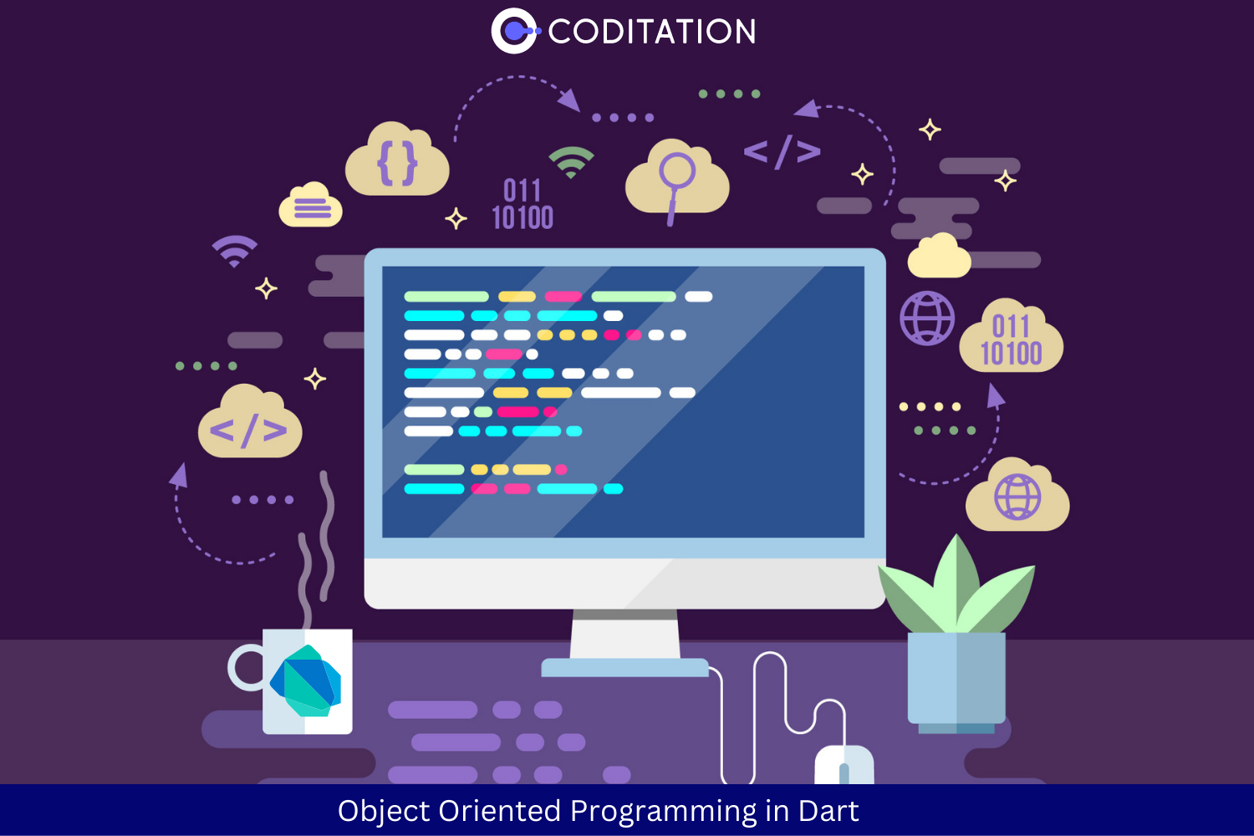
Object Oriented Programming in Dart
Prepared by : Jubi Marva

Slide 2
Object Oriented Programming
Object-oriented programming (OOP) is a way of writing computer programs. Instead of just writing lines of code, we organize our code around things called “objects.” These objects can be anything, like a person, a bank account, or a car.
Each object has its own special features (we call them “attributes”) and things it can do (we call them “behavior”). For example, if our object is a person, they might have features like a name, age, and height, and they can do things like walking and talking.
Advantage - It enhances code organization, promotes reusability, and simplifies the development process. By structuring code around objects, developers can create modular components that are easier to test, maintain, and extend.

Slide 3
Four Concepts of OOPS: 1. Inheritance 2. Polymorphism 3. Abstraction

Slide 4
Content : 1. Class 2. Objects 3. Functions 4. Constructor 5. this keyword 6. Setters/Getters 7. Class Inheritance 8. Abstract methods and classes 9. Interface 10. Polymorphism

Slide 5
Class
Class is the blueprint of objects and class is the collection of data members and data function means which include these fields, getter and setter, and constructor and functions.
class class_name { // Body of class }
Class is the keyword used to initialize the class.
class_name is the name of the class.
The body of the class consists of fields, constructors, getter and setter methods, etc.

Slide 6
Class - Definition
Fields - are the variables which data for the objects which means Declaration Part.
Constructor - is a block of code that initializes the state and values during object creation. Constructor is name same as the class name and doesn’t return any value.
Setter/Getter – Getter is used to read or get the data of the class field whereas setter is used to set the data of the class field to some variable.
Function – Functions refers to the action an object can take. It can also be called as methods
class Student{
//field
String name = “Name”;
//function
void Show(){
Print(name)
}}

Slide 7
Object
Objects are the instance of the class and they are declared by using a new keyword followed by the class name.
Syntax: var object_name = class_name([arguments]);
In the above syntax: var is the keyword use to declare the instance of the class
object_name is the name of the object and its naming is similar to the variable name in dart.
class_name is the name of the class whose instance variable is been created.
arguments are the input which are needed to be pass if we are willing to call a constructor. After the object is created, there will be the need to access the fields which we will create. We use the dot(.) operator for that purpose.
// For accessing the property
object_name.property_name;
// For accessing the method
object_name.method_name();

Slide 8
Function
Function is a block of reusable code that performs a specific task. Functions can take parameters, execute a set of instructions, and return a value. They help organize code into manageable sections, making it easier to read and maintain.
int add(int a, int b)
{
return a + b;
}
void main()
{ int sum = add(3, 5);
print('The sum is: $sum’);
}

Slide 9
4 Types
Defining a function - a function definition requires when and how a specific task would be done.
Calling a function - A function must be called in order to execute it.
Returning functions - functions may also return values back along with the control, to the caller. Also there is a possibility to return Null value in the time of execution.
Parameterised functions - Parameters are a mechanism to pass values between the function.we can pass more than one parameter or what our object we want. But to receive, we must define data type.

Slide 10
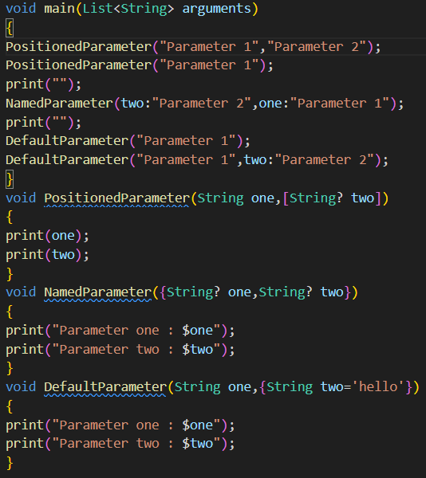
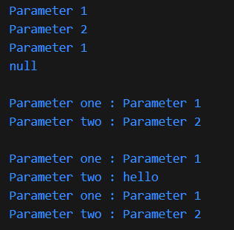
Parameter Function Types
In Dart, function parameters can be categorized into three main types:
1. Optional Positional Parameter - These parameters are enclosed in square brackets []. They can be omitted when calling the function, and if not provided, they default to null.
2. Optional Named Parameter – These parameters are enclosed in curly braces {} and can be provided in any order when calling the function. They can also have default values.
3. Optional Parameter with Default value - Function parameters can also be assigned values by default.

Slide 11
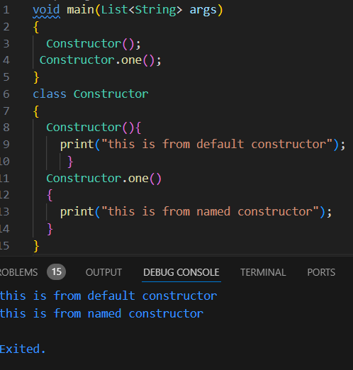
Constructors
Constructors are special functions that create instances of classes.
Dart implements many types of constructors. Except for default constructors, these functions use the same name as their class.
There are named constructors in dart, which will allow us to create and call by the default name we create. This constructor will only execute only if its called by that name. A class can have as many named parameters.
Named Constructor - Use a named constructor to implement multiple constructors for a class or to provide extra clarity:

Slide 12
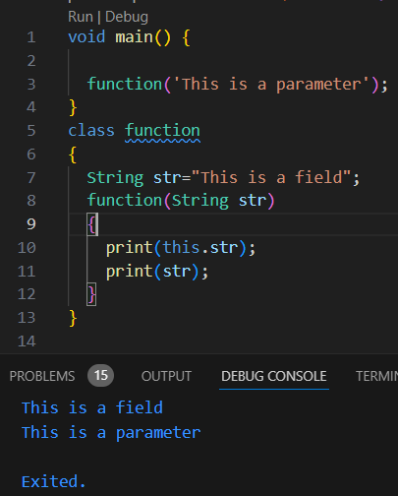
this keyword
this keyword represents an implicit object pointing to the current class object. It refers to the current instance of the class in a method or constructor. this keyword is mainly used to eliminate the ambiguity between class attributes and parameters with the same name.

Slide 13
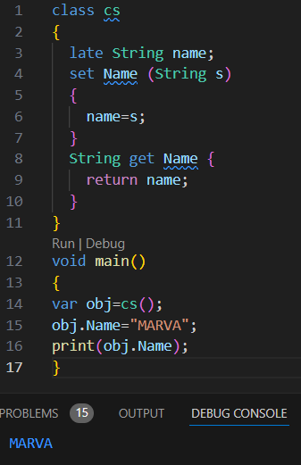
Setters / Getters
Getter and setter methods are the class methods used to manipulate the data of the class fields. Getter is used to read or get the data of the class field whereas setter is used to set the data of the class field to some variable.

Slide 14
Class Inheritance
In Dart, one class can inherit another class i.e dart can create a new class from an existing class. We make use of extend keyword to do so.
Terminology:
Parent Class: It is the class whose properties are inherited by the child class. It is also known as a base class or superclass.
Child Class: It is the class that inherits the properties of the other classes. It is also known as a deprived class or subclass
Types of Inheritance:
Single Inheritance: This inheritance occurs when a class inherits a single-parent class.
Multiple Inheritance: This inheritance occurs when a class inherits more than one parent class. Dart doesn’t support this.
Multi-Level Inheritance: This inheritance occurs when a class inherits another child class.
Hierarchical Inheritance: More than one classes have the same parent class.

Slide 15
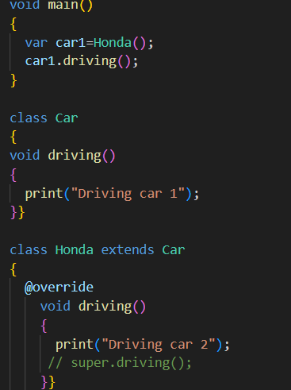
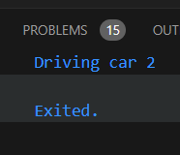
Polymorphism
Polymorphism is exemplified in Dart by the @override metatag. With it, a subclass's implementation of an inherited behavior can be specialized to be appropriate to its more specific subtype. When a class has properties that are themselves instances of other classes, it's using composition to add to its abilities.

Slide 16
Super keyword
In Dart, super keyword is used to refer immediate parent class object. It is used to call properties and methods of the superclass. It does not call the method, whereas when we create an instance of subclass than that of the parent class is created implicitly so super keyword calls that instance.
Advantages of super keyword:
It can be used to access the data members of parent class when both parent and child have member with same name.
It is used to prevent overriding the parent method.
It can be used to call parameterized constructor of parent class.

Slide 17
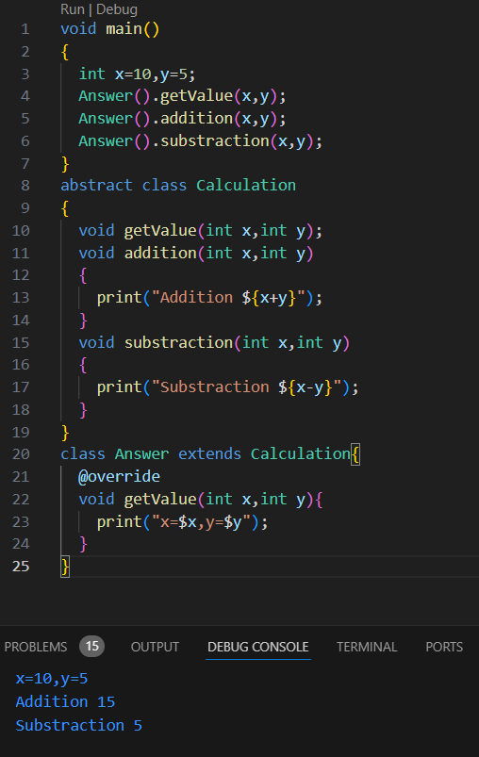
Abstract Class & Methods
An abstract class in Dart is defined as a class that contains one or more abstract methods (methods without implementation). To declare an abstract class, we use the abstract keyword. It’s important to note that a class declared as abstract may or may not include abstract methods. However, if a class includes an abstract method, it must be declared as abstract.
Features of Abstract Class:
Abstract Methods: A class containing an abstract method must be declared abstract. An abstract class may contain both abstract and concrete methods.
Declaration: A class can be declared abstract by using the abstract keyword.
Initialization: An abstract class cannot be instantiated.
Inheritance: An abstract class can be extended, but any subclass must implement all abstract methods.
Syntax : abstract class ClassName
{
// Body of the abstract class
}

Slide 18
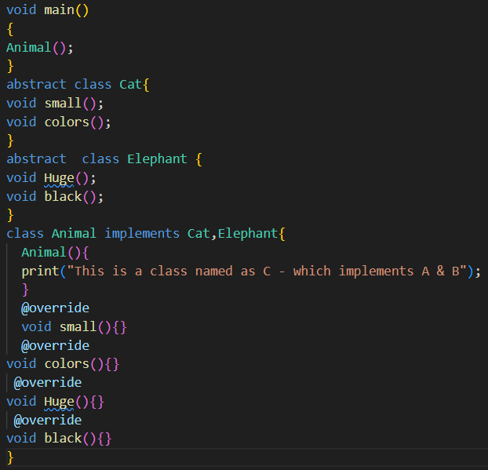

Interface
The interface in the dart provides the user with the blueprint of the class, that any class should follow if it interfaces that class
i.e. if a class inherits another it should redefine each function present inside an interfaced class in its way. They are nothing but a set of methods defined for an object.
Dart doesn’t have any direct way to create inherited class, we have to make use of implements keyword to do so.

Slide 19
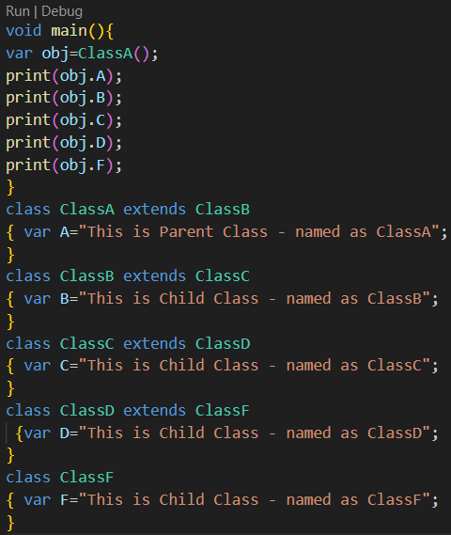
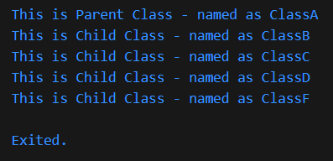
Exercise:
Multiple hierarchy
* Create a class A
* Create a class B and a variable with any value
* Create a class C and a variable with any value
* Create a class D and a variable with any value
* Create a class F and a variable with any value
Inherit all classes to class A
Create object for class A , and print variables inside other classes With that object. Do not use interface

Slide 20
Thank You
Prepared by :
Jubi Marva
Flutter Developer
jubimarva12@gmail.com
Aitrich Academy

